Slide 1

Author Attribution Using Stylometry
Presented by: Destiny Hillis
Course Information: CSPB 4830 – Natural Language Processing
Instructor/Semester: Dr. Curry Guinn / Spring 2025
Notes:
Hello, my name is Destiny Hillis, and today I’ll be presenting my project on "Author Attribution Using Stylometry."

Slide 2

Problem Overview
Focus on authorship attribution using stylistic analysis.
Aim to classify texts based on writing style.
Important for forensic linguistics and plagiarism detection.
Challenge lies in subtle style differences detection.
Notes:
The core task I’m tackling is authorship attribution—the process of identifying who wrote a given text based on its stylistic features, rather than its content.
This has real-world applications in areas like forensic linguistics, where we might want to verify the author of a threatening letter, or in plagiarism detection, where stylistic fingerprints can reveal when someone’s submitted or published work that isn’t their own.
The challenge lies in how subtle and nuanced writing styles can be—especially between similar authors or genres. These distinctions are not always easy for humans to detect, but stylometric and machine learning techniques can help.
Photo by Thomas Kelley on Unsplash

Slide 3
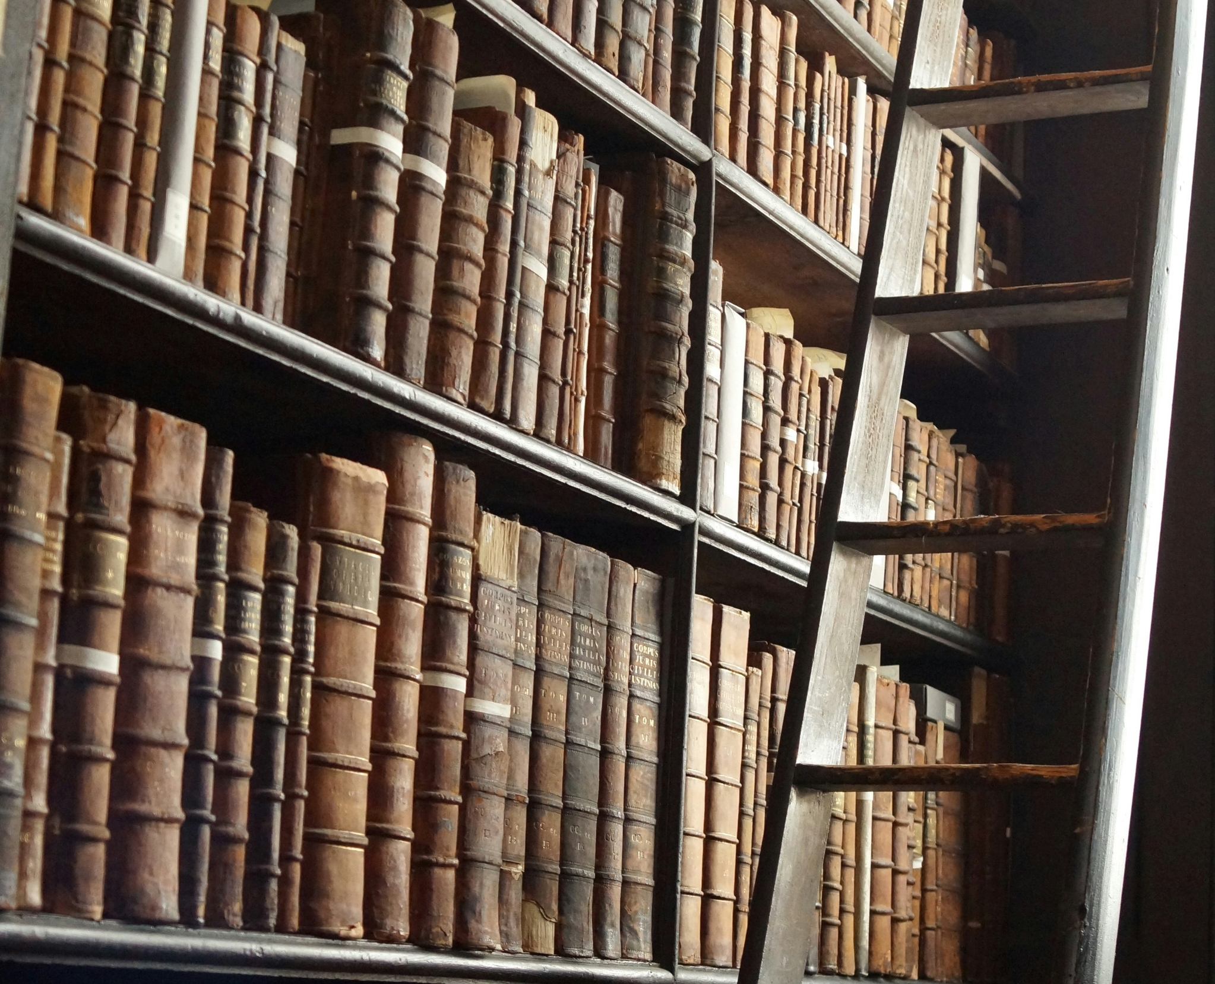
Motivation & Goals
Main goal: Compare feature-based and deep learning methods.
Key question: Can BERT outperform classic methods?
Exploring real-world authorship debates as a bonus goal.
Notes:
The main goal of my project is to compare traditional, feature-based methods of authorship attribution with a more modern, transformer-based approach using deep learning.
The key question I’m exploring is: Can a model like BERT outperform classic stylometric classifiers like Support Vector Machines (SVM) or Random Forest?
Photo by Tim van Cleef on Unsplash

Slide 4

Dataset Description
Dataset: Project Gutenberg corpus
Key preprocessing tasks include removal of metadata, POS tagging, tokenization and feature extraction.
Notes:
The two primary datasets I’m using are:
The Project Gutenberg Corpus, accessed via NLTK, which includes public domain literary texts from a range of authors.
Key preprocessing tasks include the removal of metadata like forwards, headers, and footnotes, part-of-speech tagging, tokenization, and feature extraction.

Slide 5

Approach Overview
Two methodologies: Feature-based and transformer-based.
Feature-based stylometry involves classifiers like Support Vector Machines (SVM) and Random Forest.
Transformer-based classification uses fine-tuned BERT.
Notes:
Like mentioned previously, my project is structured around two methodologies:
A feature-based pipeline, which involves extracting stylometric features—such as average word length, punctuation frequency, and part of speech tag distributions, to name a few—and feeding them into traditional classifiers like SVM and Random Forest. In my code, I’m trying both and then selecting whichever produces the best score.
The second methodology is a transformer-based pipeline, where I fine-tune a BERT model using the Hugging Face Transformers library to classify authors based on contextual embeddings instead of features.

Slide 6
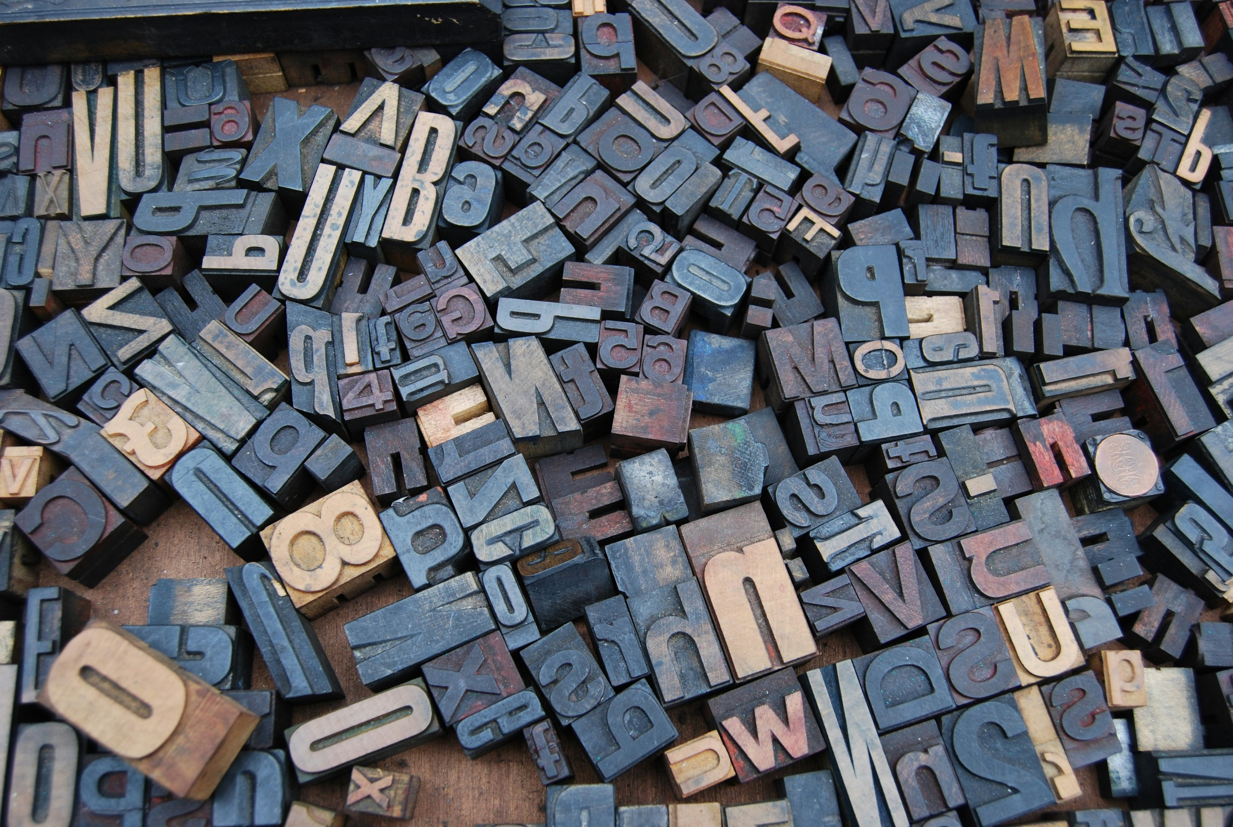
Tools & Techniques
Employing NLTK for text preprocessing.
Utilizing Scikit-learn for ML models.
BERT model fine-tuning via Hugging Face Transformers.
Matplotlib and Seaborn libraries for visualization.
Notes:
For tools and libraries:
I’m using NLTK for text preprocessing and POS tagging.
Scikit-learn provides the machine learning models SVM and Random Forest.
Hugging Face Transformers is used for BERT fine-tuning.
I’ve incorporated Matplotlib and Seaborn libraries to better visualize, evaluate, and compare the results.
Photo by Amador Loureiro on Unsplash

Slide 7

Experiments & Analysis
Dataset preprocessing
Built two pipelines: feature-based (SVM/Random Forest) and transformer-based (BERT)
Extracted lexical, syntactic, and structural features from literary datasets
Evaluating both models using precision, recall, F1-score, and confusion matrices
Visualizations to aid in analysis
Notes:
Here’s a quick summary of the experiments and analysis I’ve done:
Preprocessing of the Gutenberg dataset included stripping out metadata like headers, footnotes, etc., tokenization, and splitting text samples into manageable chunks. This ensures the data is ready for feature extraction and model training
I’ve built 2 author attributor pipelines, one feature-based and one transformer-based.
Feature-Based Stylometry involves extracting features from text at three levels:
Character-level: Includes average word length, punctuation frequency, and n-grams.
Word-level: Measures vocabulary richness, sentence length, and function word usage.
Syntax-level: Analyzes part-of-speech (POS) tag frequencies.
These features are combined into a unified representation for training models like SVM and Random Forest.
For the Transformer-Based method, I’m using a pre-trained transformer model, bert-based-uncased, that I use to extract dense embeddings for text samples.
These embeddings are used to train an SVM classifier.
This approach leverages the power of deep learning for author attribution.
Both models were evaluated manually using precision, recall, F1-score, accuracy, and confusion matrices. I also went a step beyond this and automated the analysis of predictions from both models compared to ground truth, focusing on accuracy, model agreement, and identifying instances of disagreement.
Photo by Anne Nygård on Unsplash

Slide 8
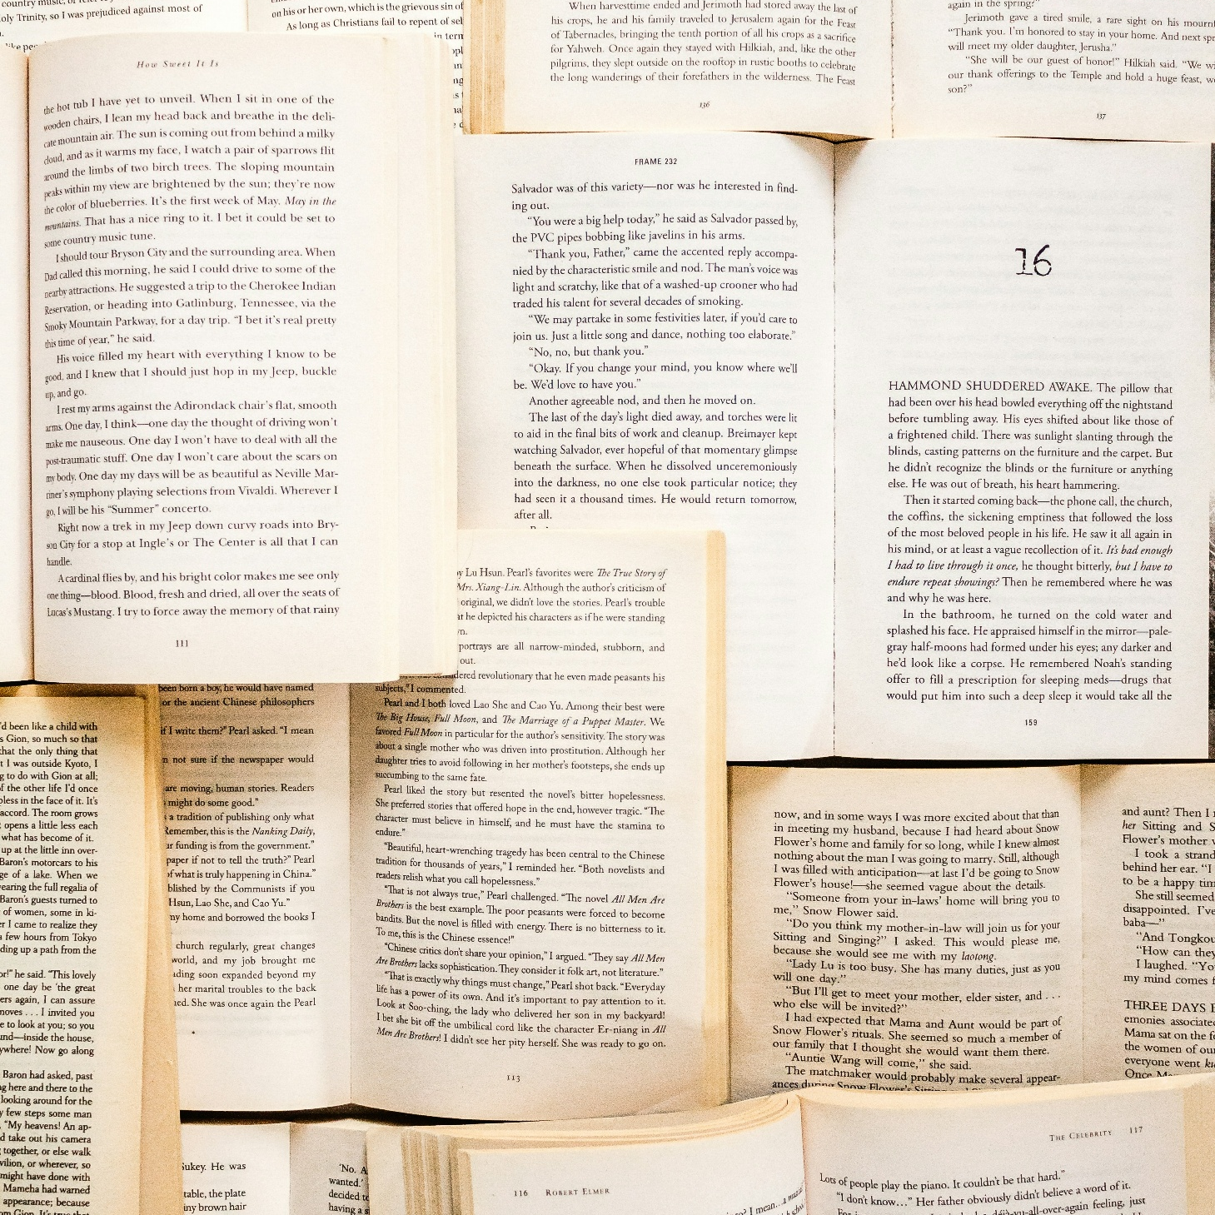
Results
Automated the analysis of predictions and ground truth
Accuracy
model agreement
instances of disagreement
Manual comparison of metrics
Accuracy
Precision
Recall
F1-score
confusion matrices
Notes:
In this section, I’ll compare the performance of two approaches for author attribution: feature-based stylometry and transformer-based embeddings. I analyzed their accuracy, precision, recall, F1-scores, and confusion matrices across six datasets, highlighting key differences and insights.
Photo by Sincerely Media on Unsplash

Slide 9
Accuracy
Set 1
Set 2
Set 3
Set 4
Set 5
Set 6
FEATURE
0.78
0.99
0.78
0.79
0.93
0.76
TRANS-FORMER
0.98
1.0
0.98
0.98
0.98
0.95
austen-emma.txt
chesterton-brown.txt
shakespeare-hamlet.txt
bible-kjv.txt
blake-poems.txt
bryant-stories.txt
burgess-busterbrown.txt
carroll-alice.txt
chesterton-ball.txt
austen-persuasion.txt
chesterton-thursday.txt
shakespeare-macbeth.txt
melville-moby_dick.txt
milton-paradise.txt
shakespeare-caesar.txt
austen-sense.txt
edgeworth-parents.txt
whitman-leaves.txt
Notes:
Across all datasets, the transformer-based model consistently outperforms the feature-based model in accuracy and other metrics. For example:
In Set 1, the feature-based model achieved 78% accuracy, while the transformer-based model reached 98%.
Similarly, in Set 6, the feature-based model had 76% accuracy, compared to 95% for the transformer-based model.
This trend demonstrates the ability of transformers to capture complex patterns in text, which handcrafted features may miss.

Slide 10
Precision
Set 1
Set 2
Set 3
Set 4
Set 5
Set 6
Austen
Bible
Burgess
Austen
Melville
Austen
FEATURE
0.79
1.0
0.79
0.77
0.96
0.69
TRANS-FORMER
0.98
1.0
0.98
0.99
0.99
0.91
Chesterton
Blake
Carroll
Chesterton
Milton
Edgeworth
FEATURE
0.74
0.68
0.72
0.78
0.87
0.73
TRANS-FORMER
0.96
0.93
0.99
0.96
0.97
0.94
Shakespeare
Bryant
Chesterton
Shakespeare
Shakespeare
Whitman
FEATURE
0.84
0.91
0.79
0.94
0.83
0.87
TRANS-FORMER
0.99
0.99
0.98
1.0
1.0
0.91
Notes:
"Looking deeper into precision, recall, and F1-scores:
Precision: The transformer model consistently achieves higher precision across all datasets. For instance, in Set 5, the transformer model's precision for all classes exceeds 97%, while the feature-based model's precision ranges from 83% to 96%.

Slide 11
Recall
Set 1
Set 2
Set 3
Set 4
Set 5
Set 6
Austen
Bible
Burgess
Austen
Melville
Austen
FEATURE
0.90
1.0
0.47
0.87
0.96
0.64
TRANS-FORMER
0.99
1.0
0.96
0.97
0.99
0.91
Chesterton
Blake
Carroll
Chesterton
Milton
Edgeworth
FEATURE
0.53
0.39
0.63
0.65
0.90
0.77
TRANS-FORMER
0.95
0.93
0.95
0.98
0.97
0.94
Shakespeare
Bryant
Chesterton
Shakespeare
Shakespeare
Whitman
FEATURE
0.81
0.95
0.91
0.89
0.71
0.86
TRANS-FORMER
0.99
0.99
1.0
1.0
0.94
1.0
Notes:
Recall: Transformers also excel in recall. In Set 3, the transformer model achieves near-perfect recall for all classes, while the feature-based model struggles, especially for class 0, with only 47% recall.

Slide 12
F1-Score
Set 1
Set 2
Set 3
Set 4
Set 5
Set 6
Austen
Bible
Burgess
Austen
Melville
Austen
FEATURE
0.84
1.0
0.59
0.81
0.96
0.66
TRANS-FORMER
0.98
1.0
0.97
0.98
0.99
0.91
Chesterton
Blake
Carroll
Chesterton
Milton
Edgeworth
FEATURE
0.62
0.49
0.67
0.71
0.89
0.75
TRANS-FORMER
0.96
0.93
0.97
0.97
0.97
0.94
Shakespeare
Bryant
Chesterton
Shakespeare
Shakespeare
Whitman
FEATURE
0.83
0.93
0.84
0.91
0.76
0.86
TRANS-FORMER
0.99
0.99
0.99
1.0
0.97
0.99
Notes:
F1-Score: The F1-scores reflect the same pattern, with transformers achieving scores close to 1.0 in most cases, indicating a balanced performance across precision and recall."

Slide 13
Confusion Matrices
Set 1
Austen FEAT.
Austen TRAN.
Chesterton FEAT.
Chesterton TRAN.
Shakespeare FEAT.
Shakespeare TRAN.
Austen
849
946
79
13
18
1
Chesterton
196
23
233
404
10
0
Shake-speare
33
0
2
2
149
180
Set 2
Bible FEAT.
Bible TRAN.
Blake FEAT.
Blake TRAN.
Bryant FEAT.
Bryant TRAN.
Bible
4720
4733
1
2
6
0
Blake
5
1
17
38
22
2
Bryant
7
2
7
1
269
275
Notes:
Confusion matrices provide a visual representation of model performance:
In Set 2, the transformer model shows almost perfect predictions, with minimal misclassifications. In contrast, the feature-based model misclassifies several samples, particularly for class 1.

Slide 14
Confusion Matrices
Set 3
Burgess FEAT.
Burgess TRAN.
Carroll FEAT.
Carroll TRAN.
Chesterton FEAT.
Chesterton TRAN.
Burgess
55
89
10
1
52
3
Carroll
3
2
103
159
57
7
Chesterton
12
0
31
0
411
473
Set 4
Austen FEAT.
Austen TRAN.
Chesterton FEAT.
Chesterton TRAN.
Shakespeare FEAT.
Shakespeare TRAN.
Austen
428
474
62
16
4
0
Chesterton
121
6
266
341
2
0
Shake-speare
10
0
2
0
93
111
Notes:
In Set 4, the feature-based model confuses class 0 and class 1 more frequently, while the transformer model maintains high accuracy with fewer errors.

Slide 15
Confusion Matrices
Set 5
Melville FEAT.
Melville TRAN.
Milton FEAT.
Milton TRAN.
Shakespeare FEAT.
Shakespeare TRAN.
Melville
1238
1266
38
10
8
0
Milton
37
13
430
466
10
0
Shake-speare
11
2
24
6
85
118
Set 6
Austen FEAT.
Austen TRAN.
Edgeworth FEAT.
Edgeworth TRAN.
Whitman FEAT.
Whitman TRAN.
Austen
462
644
230
60
33
3
Edgeworth
172
63
805
979
65
4
Whitman
35
1
66
2
633
745
Notes:
These matrices highlight the transformer's ability to distinguish between authors more effectively.

Slide 16
Comparing Predictions to Ground Truth
Set 1
Model Comparison
Per Author Accuracy
0.8183
Austen
Chesterton
Shakespeare.
FEATURE
FEATURE
0.9218
0.5684
0.8593
TRANSFORMER
0.9950
TRANSFORMER
0.9971
0.9892
0.9978
AGREEMENT
0.8178
SAMPLES
4796
2136
910
Disagreements
Found 1429 examples where models disagree.
Example 1
Text snippet: [ Emma by Jane Austen 1816 ] VOLUME I CHAPTER I Emma Woodhouse , handsome , clever , and rich , with...
True author: Austen
Feature-based prediction: Chesterton
Transformer-based prediction: Austen
Example 2
Text snippet: and how nursed her through the various illnesses of childhood . A large debt of gratitude was owing ...
True author: Austen
Feature-based prediction: Chesterton
Transformer-based prediction: Austen
Example 3
Text snippet: and who had such an affection for her as could never find fault . How was she to bear the change ? -...
True author: Austen
Feature-based prediction: Chesterton
Transformer-based prediction: Austen
Notes:
While the transformer model outperforms the feature-based model, it's worth noting areas of disagreement found in comparing the prediction outputs to the ground truth:
For example, in Set 1, disagreements often occur for samples with overlapping stylistic features between authors.
These disagreements can provide insights into the limitations of each approach and guide further improvements.
I’m only showing set 1 in this presentation, but all other sets and even more information on this comparison can be found in the Jupyter notebook containing my code.
As you can see, all of the transformer-based model metrics are better than those of the feature-based model across all datasets. While feature-based stylometry offers interpretability, transformers excel in capturing nuanced patterns, making them more effective for author attribution tasks.

Slide 17

Challenges & Lessons Learned
Couldn't include the PAN dataset due to approval delays and preprocessing issues.
Stretch goal (using models to explore a literary question) not reached—more on next slide.
Metadata removal (e.g., author/title) was imperfect and may have skewed results.
Stylometric features vary by text length, complicating comparisons.
Splitting Gutenberg into subsets led to author imbalance (e.g., Austen, Chesterton, Shakespeare).
Feature normalization was mixed—chunk size consistency helped, but runtime limits forced compromises.
BERT may have suffered from topic leakage; fine-tuning on a narrower dataset may help.
Comparing such different model types fairly was a key learning experience.
Notes:
Along the way, I’ve encountered several challenges:
First, I intended to also use the PAN dataset, which is a well-established benchmark in authorship attribution research. But due to time constraints, I wasn’t able to include it in this iteration. The newer PAN datasets require approval and I wasn’t able to receive it in time. I found older versions available, but they are not the easiest to parse and use. I wasn’t able to get the more extensive preprocessing code working in time for it to be part of this project.
This means I also didn’t have time to even consider my stretch goal of using my author attribution models to aid in answering an open literary question. I’ll talk more about this in the next slide.
My attempt to remove metadata like headers and footers was not very sophisticated and I found it sometimes left the author/title in the first chunk of the text sample. You likely noticed this in the Comparing Predictions to Ground Truth slide. This likely skewed some of the results especially in the transformer method, but the feature based approach seemed to completely ignore this because it often guessed the wrong author on these chunks.
Also, stylometric features can vary significantly based on the length of the text, which complicates comparisons.
Another challenge I encountered was needing to split the full Gutenberg dataset into smaller subsets to avoid timeouts and long runtimes. I could have improved this process by sorting or randomizing the chunks more effectively to ensure more balanced results. For instance, two subsets ended up containing works by Austen, Chesterton, and Shakespeare—simply because their texts dominate the corpus. A more thoughtful distribution would have produced better representation.
I’ve had to be careful about normalizing features to avoid skewed results. (e.g., to control for differences in text length or frequency ranges before feeding them into classifiers.) I did this with mixed success. Although I was comparing the same size chunks, I ran into issues with the dataset being too large to run without runtime timing out (even on GPU). I had to separate the corpus into smaller subsets of 3 authors/works each, which is less than ideal for the most accurate results.
In the deep learning pipeline, BERT might classify texts based on subject matter rather than true stylistic patterns. This is called topic leakage and I’m not sure I did enough to address it. I may need to further fine-tune the model on a more focused dataset.
Finally, deciding how to fairly compare such fundamentally different model architectures has been an important learning experience.
Photo by Prateek Katyal on Unsplash

Slide 18

Conclusion & Future Work
Apply models to disputed authorship cases (e.g., Zelda vs. F. Scott Fitzgerald)
Experiment with feature fusion: combine stylometric features with BERT embeddings
Notes:
In summary, this project aimed to evaluate whether deep learning models like BERT can outperform traditional stylometric techniques in author attribution and it’s pretty clear that’s a resounding “yes”.
Looking ahead, I plan to:
I mentioned I wanted to apply the models to literary attribution debates. Specifically, I’m interested in the controversial idea that F. Scott Fitzgerald may have published some of his wife, Zelda’s, works as his own. This has been an ongoing dispute for the past century and it would be fun to use NLP to help determine a potential answer.
I would also like to explore hybrid approaches that combine the precision of stylometry with the semantic depth of transformer models. Logically this seems like it would provide the best accuracy, taking advantage of the best of both worlds.
Thanks so much for listening and I appreciate any feedback you may have.
Photo by Peter Herrmann on Unsplash

